Slide 1

Video Game Sales Trends and Analysis
Presented by: Sara Hill

Slide 2
Overview
Gaming industry has changed drastically since the early 70s.
This analysis seeks to provide insight into how video games are rated and how those ratings affect sales

Slide 3
Goals
Are video games getting worse throughout the years or are they getting better?
Do user and critic ratings affect how many copies are being sold and shipped out?

Slide 4
The Data
The data contains:
Content for over 13,000 video games
Ranges from the years 1977 – 2020
Came directly from the VGChartz database
Majority of the User and Critic scores were entered manually from MetaCritic
Data Types: string, float, and integers
There are 9 columns in the original data set containing: Rank, Name, Platform, Publisher, Developer, Critic Score, User Score, Total Shipped, and Year
Data gathered from Kaggle.

Slide 5
Hypotheses
Hypothesis 1:
Ho: Video games ratings are not changing based off the year.
Ha: Video games ratings are on a decline based off the year.
Hypothesis 2:
Ho: User and critic scores on video games do not affect how many copies of the games are being bought by customers.
Ha: User and critic scores on video games affect how many copies of the games are being bought by customers.

Slide 6
Methods Used
Imported CSV file and Modules into Jupyter Notebook
Data Exploration, Cleaning, and Descriptive Statistics
Checked for Correlation with Pearsonr
Split data into sample populations through conditional filtering
Checked sample population distribution with Histograms
Performed statistical analysis using t-test
Found 95% confidence intervals

Slide 7
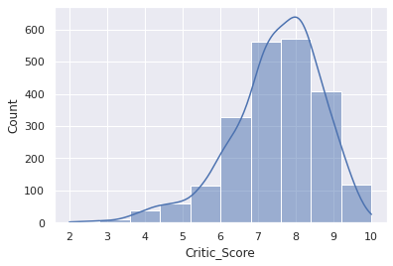
Hypothesis 1 Testing Results
We reject the null hypothesis.
There is a significant difference at the < 0.05 level in the average scores in 2011 and 2019.
With 95% Confidence, there is a difference in means of 7.4 critic/user scores and 7.5 critic/user scores.

Slide 8
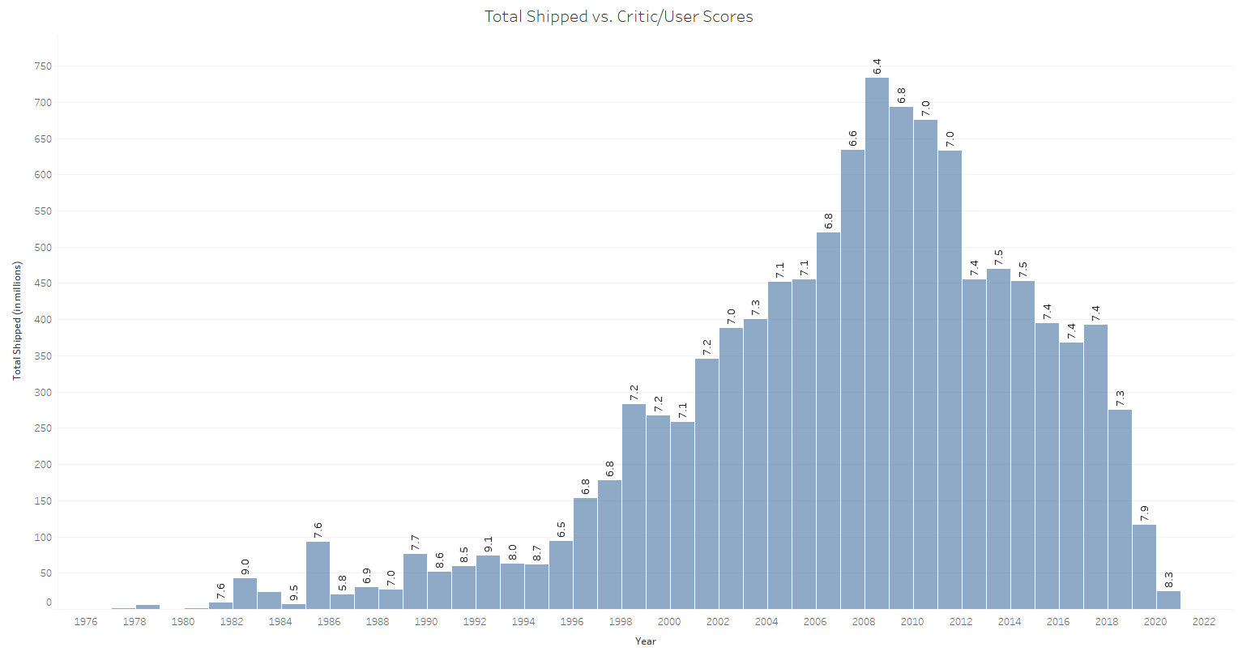
Hypothesis 2 Testing Results
We reject the null hypothesis.
There is a significant difference at the < 0.05 level in the average number of copies sold based off the games' popularities.
With 95% confidence, there is a difference in means of 1.25 million copies sold and 1.59 million copies sold.

Slide 9
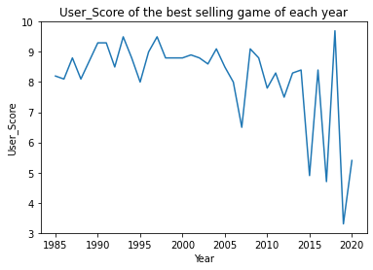
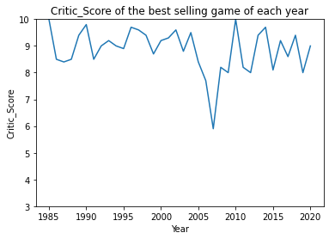
What does any of this mean?
User and Critic ratings affect how often they are bought and sold
Video Game popularity is on a decline based off the User and Critic ratings and game sales
There is a trend of newer games having lower user scores despite still selling very well
Players are more unhappy with games coming out now than before

Slide 10
Recommendations
Stakeholders should turn their focus on how video games are scored via gaming critics and their own users
The better the ratings, the higher the sales, which means more units will be sold

Slide 11
What more can be done?
Compared to all the video games that exist, this data set is still quite small
Thousands of games are also still missing ratings
To further my analysis on this project, I could:
Further research Critic/User score ratings databases and combine them with the current dataset
Gather more data on the other video games that weren’t included
Determine if there are other databases out there that have sales information based off the total units shipped

Slide 12

Questions?

